Slide 1
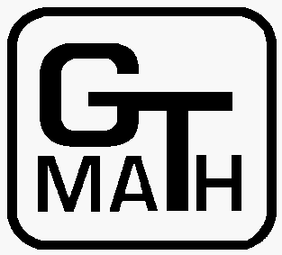
Can one hear the shape of Information?
Evans Harrell
Georgia Tech
www.math.gatech.edu/~harrell
October, 2015
Copyright 2014, 2015 by Evans M. Harrell II.

Slide 2
Can one hear the shape of Information?
What is the mathematics behind the ear's ability to pick information out of a sound signal? What sort of information do we pick out when we listen to music?
"Sonification" is the name for a current method in data science that involves turning data into sound and using the human ear to detect patterns. As we'll see, patterns are extracted from a signal through Fourier series and the Fourier transform, which I'll introduce. In order to answer the question of what kind of information we pick out, I'll discuss how the shape of an object and the sounds it makes are connected, in terms of the wave equation and associated eigenvalues. Then I'll discuss some recent research where information is instead encoded in a graph (network) and we use eigenvalues to detect some of of its features.

Slide 3
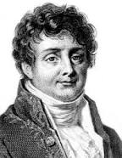
An insight of Joseph Fourier

Slide 4
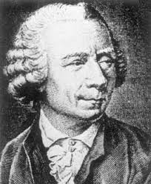
An insight of Joseph Fourier
Or, as usual, maybe of Leonhard Euler before him: “Any” sound is a superposition of pure frequencies.

Slide 5
An insight of Joseph Fourier
Or, as usual, maybe of Euler before him: “Any” sound is a superposition of pure frequencies.
Your inner ear turns out to be an instrument capable of breaking sounds into pure frequencies, multiples of
cos(ωt - φ) or exp(i(ωt))

Slide 6
Fourier series and integrals
If a signal (function) is periodic, f(t) = f(t+p), it is a sum of sine functions:

Slide 7
Fourier series and integrals
An arbitrary signal (say, square-integrable) is still an integral:

Slide 8
Fourier series and integrals
Moreover, given the signal, the formula for the coefficients is remarkably simple:

Slide 9
A recent trend in “data mining”
Turn it into music and listen. You could hear about “sonification,” example in a BBC report.

Slide 10
A recent trend in “data mining”
Anyway, it is easy, because the graph of any function can equally well be interpreted visually on Cartesian axes or as a sound wave.

Slide 11
A recent trend in “data mining”
Anyway, it is easy, because the graph of any function can equally well be interpreted visually on Cartesian axes or as a sound wave.
In Mathematica, there are two parallel commands:

Slide 12
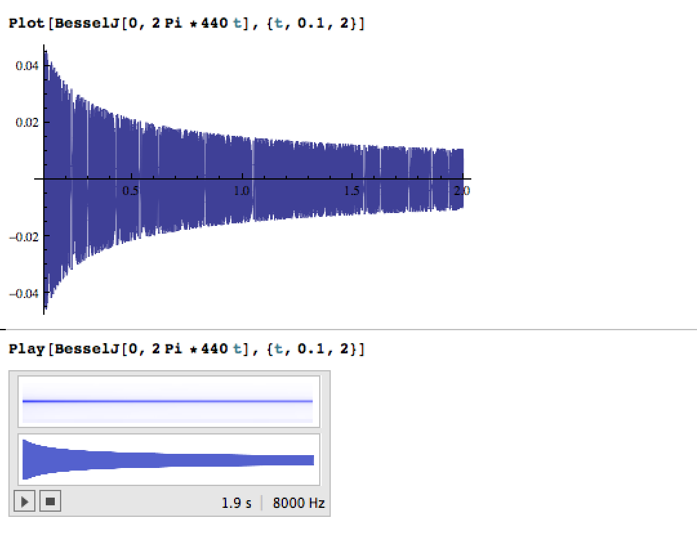

Slide 13
Examples of sonification
Cosmic microwave background
Galaxy spectra
Higgs boson
Tohoku earthquake
(compare to:Japanese drumming)
Financial market data (more randomness)

Slide 14
A recent trend in “data mining”
Turn it into music and listen.
First Life - Translating Scientific Data Into Music, a collaboration of Steve Everett, Professor of Music at Emory and Martha Grover, Chemical & Biomolecular Engineering at Georgia Tech. (Sept. 2013, at the Atlanta Botanical Garden.)
Molecular music. (March, 2014, Atlanta Science Festival.) Similar events possible in March, 2015.
European Science Café Atlanta

Slide 15
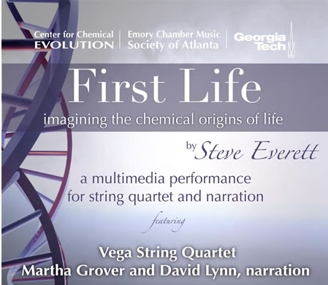
A recent trend in “data mining”

Slide 16
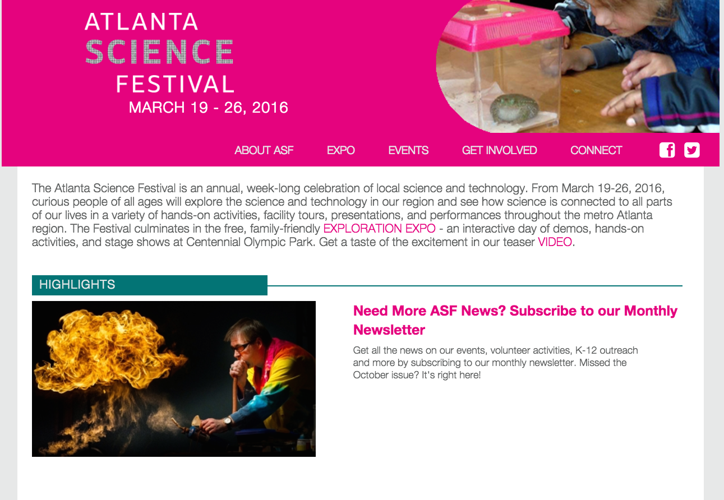

Slide 17
How are sounds produced?
Until now we have touched on how to take a sound apart into its frequencies.
Another question is: How can we put a sound together? What kinds of sounds does an object make?

Slide 18
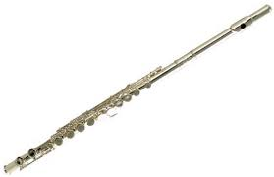
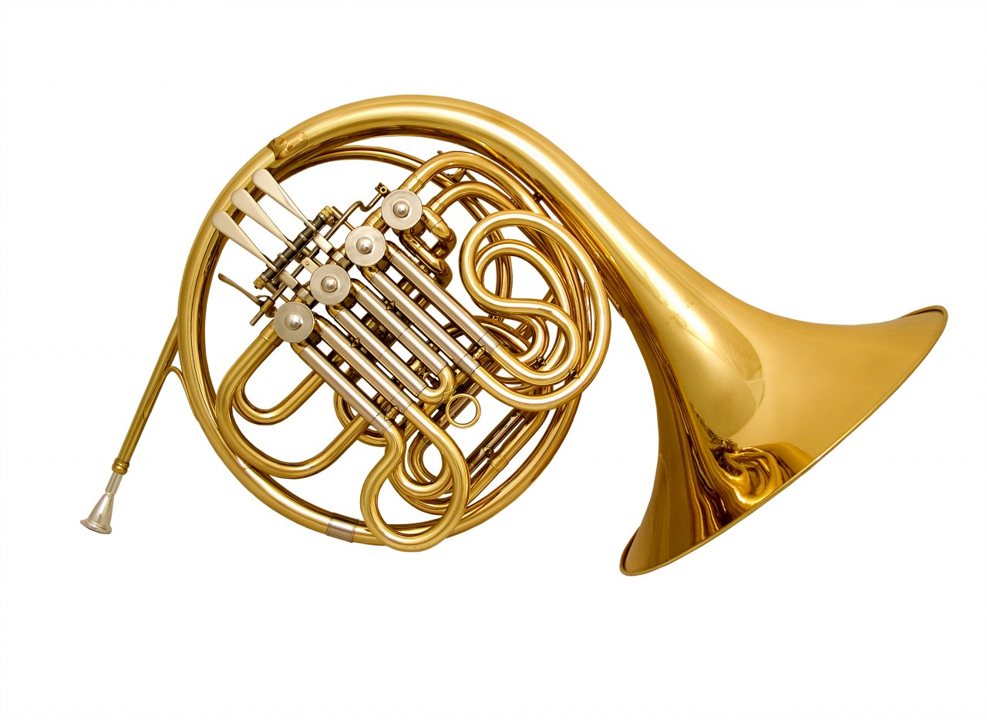
Shapes of musical instruments
Instruments that produce sustained sound (i.e., not percussion) are almost all roughly one-dimensional in some way. Either they use strings or they have one dimension that is much more extended than the others. Why?

Slide 19
How are sounds produced?
When an object vibrates, it satisfies the wave equation
u_{tt} = c² u_{xx}
along with any “boundary conditions.”

Slide 20
How are sounds produced?
When an object vibrates, it satisfies the wave equation
u_{tt} = c² u_{xx}
along with any “boundary conditions.”
Only special wave forms, called “normal modes” or “eigenfunctions” can satisfy both the DE and the BC.

Slide 21
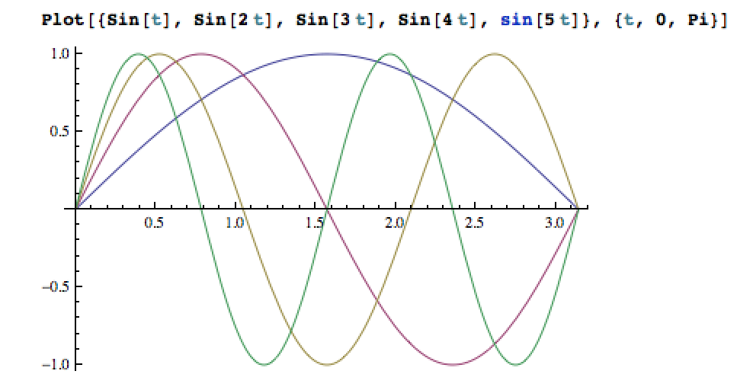
Wave forms of a vibrating string

Slide 22
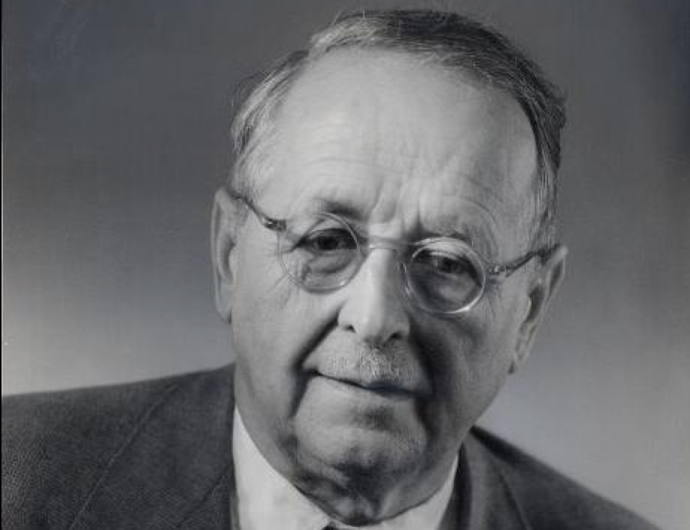
How are sounds produced?
In more than one dimension, the frequencies bunch up more thickly than the 1D values. For large k, according to the “Weyl law”
k_{m} ~ C_{ν} (m/Vol_{ν}(Ω))^{1/ν}

Slide 23
Shapes of musical instruments
If the part of a musical instrumental that produces vibrations is basically one-dimensional, then it will tend to have harmonic overtones. (The three-dimensionality only kicks in for much higher frequencies than you can hear.)

Slide 24
What do eigenvalues tell us about shapes?
Mark Kac, Can one hear the shape of a drum?, Amer. Math. Monthly, 1966.

Slide 25
What do eigenvalues tell us about shapes?
Mark Kac, Can one hear the shape of a drum?, Amer. Math. Monthly, 1966.
Already in 1946, G. Borg considered whether you could hear the density of a guitar string, but he failed to think of such a colorful title.

Slide 26
What do eigenvalues tell us about shapes?
Mark Kac, Can one hear the shape of a drum?, Amer. Math. Monthly, 1966.
Besides, the answer is now known to be “no.” However, there are some facts about the shape we can hear, because the statistical distribution of eigenvalues satisfies many conditions in which volume, surface area, and other properties appear.

Slide 27
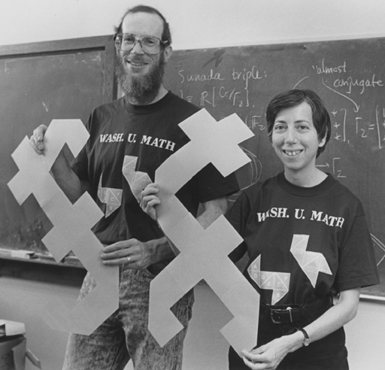
So, can one hear the shape of a drum?
Gordon, Webb, and Wolpert, 1991

Slide 28
Depending on your beliefs…
You could say that animals like you are either evolved or designed to pick out statistical relations among frequencies (eigenvalues), so that your hearing helps you make sense of your environment.

Slide 29
Depending on your beliefs…
You could say that animals like you are either evolved or designed to pick out statistical relations among frequencies (eigenvalues), so that your hearing helps you make sense of your environment.
The fact that the underlying mathematical formulae are simple made such abilities possible.

Slide 30
Shapes of musical instruments
Percussion instruments tend to have two and three-dimensional structures, but they are less used for sustained musical tones.

Slide 31
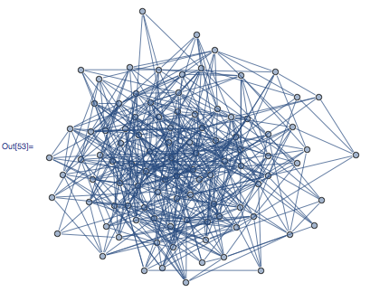
What about network data, as encoded in a combinatorial graph?

Slide 32
What about network data, as encoded in a combinatorial graph?
After my presentation to MATH 4801 in 2014, undergrad Philippe Laban worked with me to create
wikigraph
at http://wikigraph.gatech.edu/

Slide 33
What about network data, as encoded in a combinatorial graph?

Slide 34
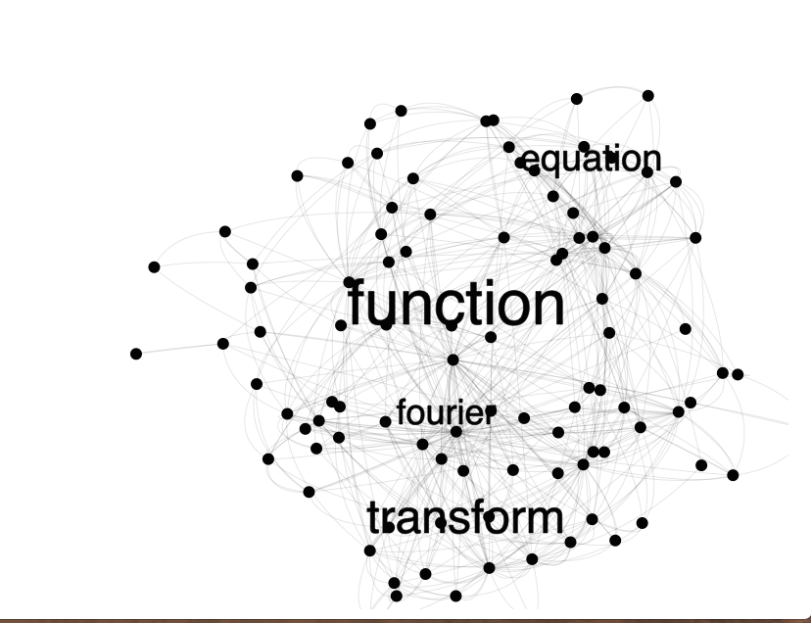
What about network data, as encoded in a combinatorial graph?

Slide 35
Let the graph vibrate, and listen to it!
On a discrete structure, there is also a wave equation and special frequencies of vibration

Slide 36
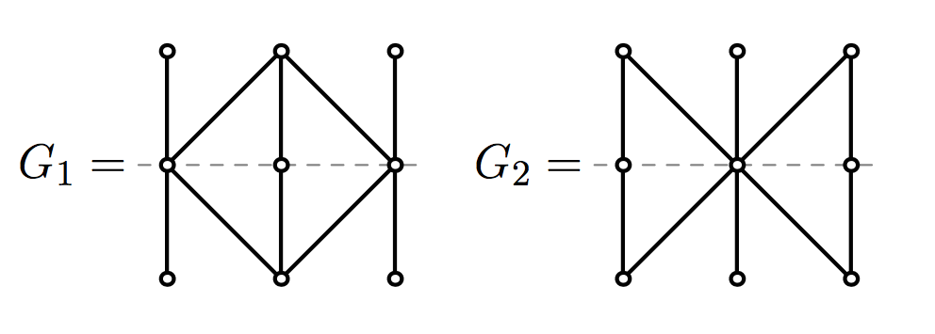
Let the graph vibrate, and listen to it!
Example of Steve Butler, Iowa State, for the “normalized Laplacian”
and adjacency matrix.
There are actually different ways to set up the discrete Laplacian, but in any version, the frequencies do not always
determine the graph.
Mouse and fish for the standard Laplacian.

Slide 37
Let the graph vibrate, and listen to it!
Nobody completely understands what sets of frequencies are possible for graphs, but there are regularities.

Slide 38
Let the graph vibrate, and listen to it!
Nobody completely understands what sets of frequencies are possible for graphs, but there are regularities.
Yay! Open problems and conjectures!

Slide 39
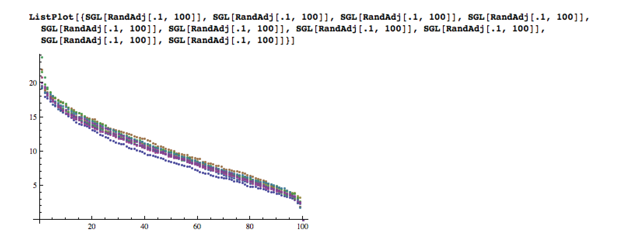

Slide 41
Dimension and complexity
A two-dimensional image can be complicated, but, as Descartes emphasized, each point in the image can be located by asking only two questions.
In this way, dimension is a measure of complexity: How many questions do you need to ask to understand the data?
Is this something one can hear?

Slide 42
Is dimension (complexity) something that one can hear?
(See Mathematica notebook)

Slide 43
Dimension and complexity
A two-dimensional image can be complicated, but, as Descartes emphasized, each point in the image can be located by asking only two questions.
In this way, dimension is a measure of complexity. As we saw, one can hear the dimension of a vibrating object.

Slide 44
Dimension and complexity
A two-dimensional image can be complicated, but, as Descartes emphasized, each point in the image can be located by asking only two questions.
In this way, dimension is a measure of complexity. As we saw, one can hear the dimension of a vibrating object.
What about a graph?

Slide 45
Dimension and complexity
This is a randomly generated “graph” showing 520 connections among 100 items. How many independent kinds of information (“dimensions”) are there?

Slide 46
Dimension and complexity
Some graphs, like regular lattices, have an obvious dimensionality. Z^{ν} can be said to have dimension ν.
.

Slide 47
Dimension and complexity
Dimension and complexity
Harrell-Stubbe, Linear Algebra and Applications, 2014.

Slide 48
Dimension and complexity
This is a randomly generated “graph” showing 520 connections among 100 items. How many independent kinds of information (“dimensions”) are there?
According to our theorem: It is only three-dimensional! The story of this graph can be understood in terms of three questions.

Slide 49
A deeper look at the statistics of spectra:

Slide 50
THE END

Slide 51
THE END

